Slide 1


Time Series Analysis: Retail Superstore Sales Forecasting
Explore the power of time series analysis in predicting retail sales. We'll dive into a global superstore's 4-year dataset, perform EDA, and forecast the next week's sales.
by Fatma Elzahraa

Slide 2

Dataset Overview
1
Time Span
Four years of retail data from a global superstore, capturing diverse market trends and seasonal patterns.
2
Granularity
Daily sales records, allowing for detailed analysis of short-term fluctuations and long-term trends.
3
Scope
Comprehensive dataset covering various product categories, regions, and customer segments for holistic insights.

Slide 3
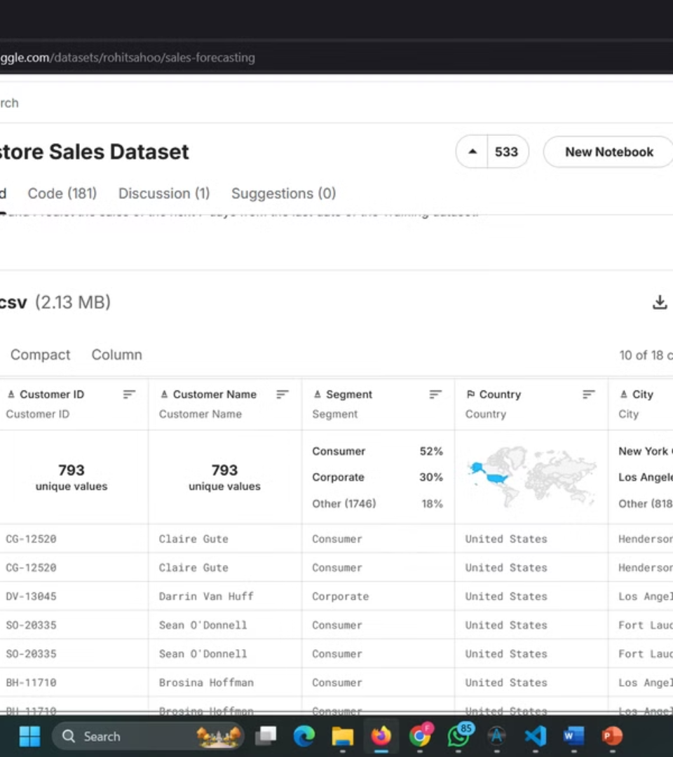
part of data set before analysis
with 18 columns

Slide 4
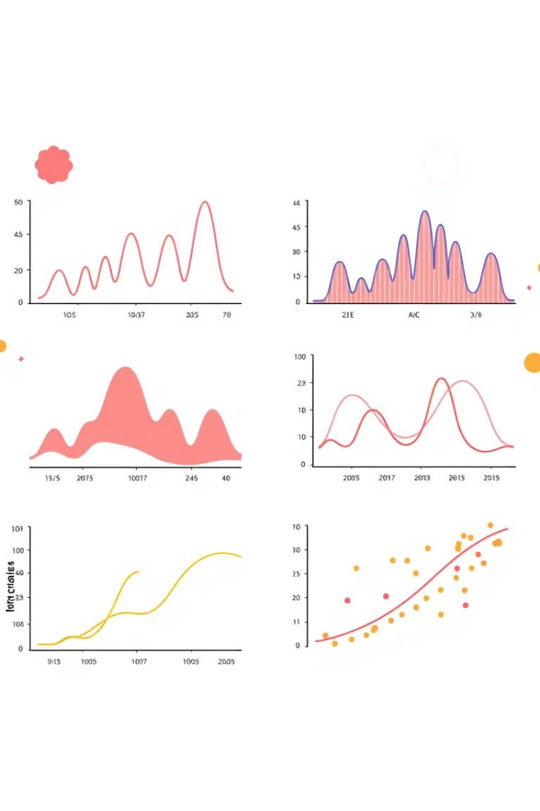
Exploratory Data Analysis (EDA)
1
Data Cleaning
Remove outliers, handle missing values, and ensure data consistency for accurate analysis.
2
Descriptive Statistics
Calculate key metrics like mean, median, and standard deviation to understand data distribution.
3
Visualization
Create time series plots, histograms, and heatmaps to identify patterns and seasonality.
4
Correlation Analysis
Examine relationships between variables to uncover potential predictors of sales performance.

Slide 5
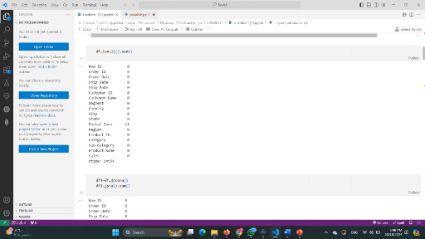
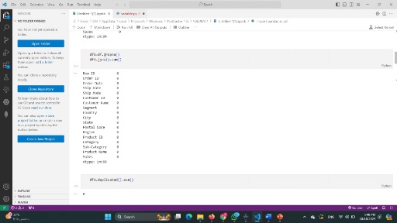
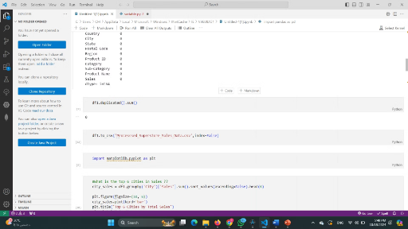
Data cleaning
count the number of null values
drop null values
count the num if there is any duplication
Remove rows with missing values, taking into account the impact on the data integrity and overall size of the dataset.
Identify columns with missing values and count the total number of nulls in each column.
Examine the dataset for duplicate rows and remove any duplicates to maintain data accuracy and prevent bias in analysis.

Slide 6
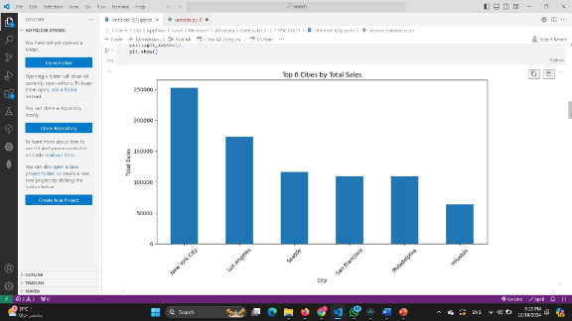
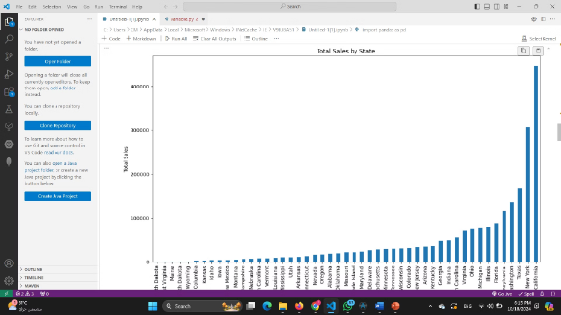
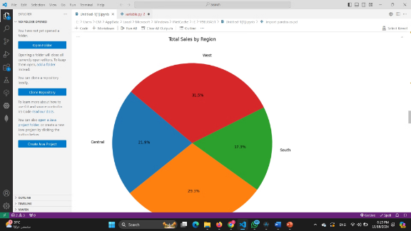
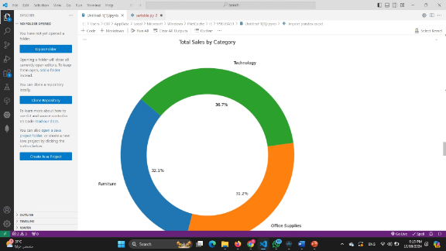
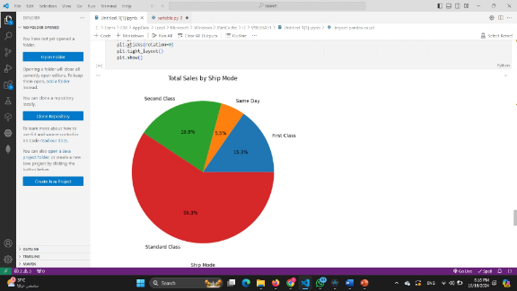
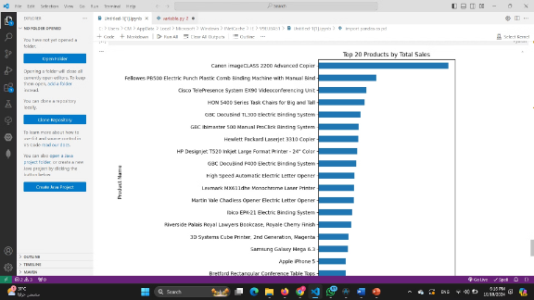
data visualization and &Exploratory analysis
Sales Trend Analysis
Product Performance
Regional Insights
Visualize the sales trend over time to identify seasonality, upward or downward trends, and potential anomalies.
Analyze the sales performance of different product categories to identify top performers, low performers, and any seasonal variations.
Explore sales patterns across different regions to understand geographic variations and potential growth opportunities.
Customer Segmentation
Correlation Analysis
Feature Engineering
Segment customers based on their purchasing behavior, demographics, or other relevant factors to tailor marketing strategies and product offerings.
Examine the correlation between different variables, such as sales, product categories, customer demographics, and time, to uncover potential drivers of sales performance.
Create new features from existing data to improve the accuracy of the forecast model.

Slide 7

we reached to insights :
we founded :
New York is the first city to take the lead in sales & last one is Huston
California ranks first in sales as a state in America
Technology sales are at the forefront
canon imageclass 2200 is the Best selling products

Slide 8

7-Day Sales Forecast
Day
Predicted Sales
Confidence Interval
Day 1
$245,678
±$12,345
Day 2
$230,456
±$11,523
Day 3
$258,901
±$12,945
Day 4
$267,890
±$13,395
Day 5
$240,123
±$12,006
Day 6
$235,678
±$11,784
Day 7
$270,456
±$13,523

Slide 9
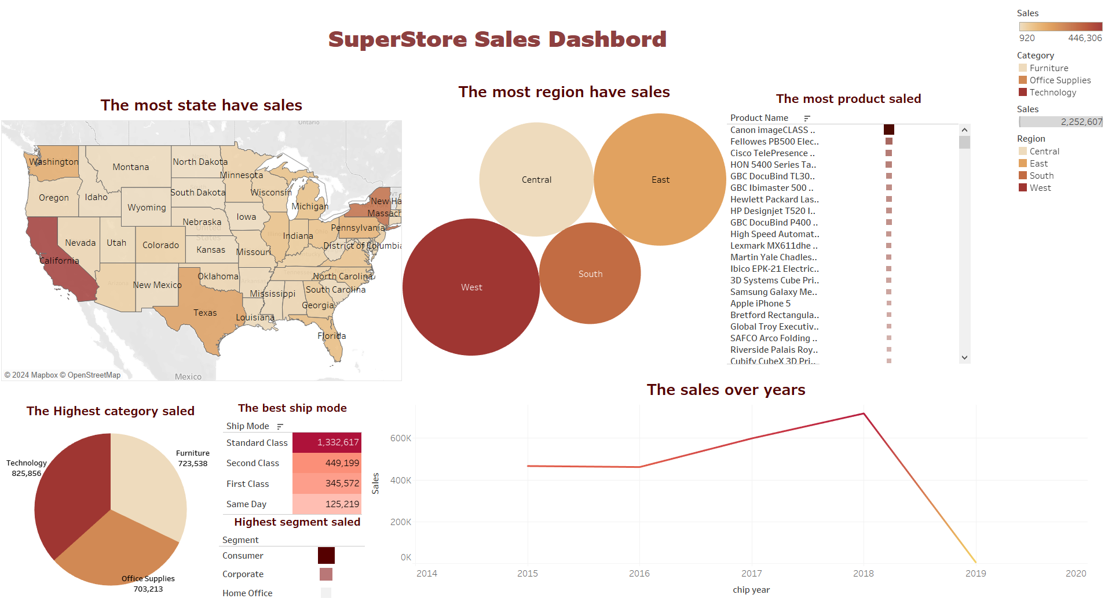
The Dashboard:

Slide 10
Thank you

